Slide 1
Raspberry PI Hack Night
By: Mike Linnen
@mlinnen
mlinnen@protosystem.net
www.protosystem.net

Slide 2
Goals:
Less talking and more hands on
Devices talking to Devices without knowing it
Event driven architecture via message contracts
Smarter devices
Highlight the Power of the Raspberry PI

Slide 3
Warning:
Security is not addressed here!!!
Do not use this code as is to power your security system
You will be hacked

Slide 4


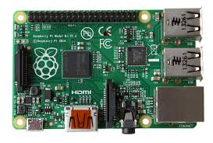



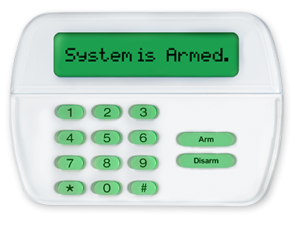
Lab: IoT Smart Doorbell
Raspberry PI
Raspberry Pi
Door 1
MQTT Broker
Pub/Sub
Door 2
Security System
Raspberry Pi
Door N

Slide 5


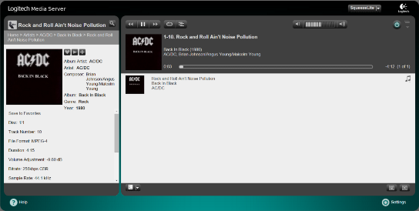
Lab: Streaming Music
Raspberry PI (p1)
Raspberry PI (p2)
Squeezelite Player
Squeezelite Player
Raspberry PI (pn)
Logitech Media Server
Squeezelite Player

Slide 6
Lets get started
Pair up in Teams
Get the Hardware
Raspberry PI 2 with SD Card and USB Power cable
Door Number (your unique door number for the lab)
Push button switch
Ethernet Cable for the PI
Lab Docs start here - http://tinyurl.com/IoTLab001
Laptop Wifi Access
Name: IoT
Password: Password$1

